Slide 1


Weekly Report NTUA 6/12/2019
George Bakas

Slide 2
Status Report
Combine Tutorial/Workshop
Signal Extraction
Various methods for extracting number of QCD events in Signal reduced mass region
Fixed eb or free eb
Unfolding
Response Matrices where Nbins Reco ~ 2Nbins Parton/Particle
Had to redo Signal extraction for unequal binning to be used in unfolding
Acceptance → reco bins (redone)
Efficiency → parton/particle bins
Unfloding technique
If square response matrix → simple inversion
If response matrix is not square:
Minimum of global correlation
L-curve method

Slide 3
Signal Extraction
Measured dist from data
QCD shape taken from Data (CR)
$$S\left(x_{reco}\right)=D\left(x_{reco}\right)−N_{QCD, reduced}^{(2)}C_{QCD}^{shape}\left(x_{reco}\right)Q\left(x_{reco}\right)−B(x_{reco})$$
Fiducial Yield
ABCD Method
QCD shape correction factor
Subdominant bkg shape and contribution (MC)
Where x_{reco} is the respected variable of interest (ttbar mass,pt, rapidity, leading and subleading jetPt and |jetY|)
We deploy a simultaneous fit in 3 regions (0,1,2 btag) because we do not have a pure Control Region.
Our data CR is ttbar contaminated
$$D{\left(m^{t}\right)}^{(i)}=N_{tt}^{(i)}T^{(i)}\left(m^{t},k_{MassScale}, k_{MassResolution}\right)+N_{bkg}^{(i)}B\left(m^{t} \right)\left(1+k_{1}x\right)+N_{sub}^{(i)}O^{(i)}\left(m^{t}\right)$$
We assume that $N_{tt}^{(0)}={\left(1−e_{b}\right)}^{2}N_{tt}, N_{tt}^{(2)}=e_{b}^{2}N_{tt} and N_{tt}^{(1)}=2\left(1−e_{b}\right)e_{b}N_{tt}$ where e_{b} is the b tagging efficiency and N_{tt} is the total ttbar yield.

Slide 4
R_{yield} Calculation (MC Closure)
2016
2017
2018

Slide 5
NQCD (2) / NQCD (0) vs eb
2016
2017
2018
We define $R_{0}=\frac{D_{red}^{\left(0\right)}}{D_{ext}^{(0)}} and R_{1}=\frac{D_{red}^{\left(0\right)}−N_{TT,MC red}^{\left(0\right)}}{D_{ext}^{\left(0\right)}−N_{TT,MC ext}^{\left(0\right)}}$ and NQCD in Reduced SR
----2016----
R0 (just data) = 0.264097
R1 (taking MC into account) = 0.262092
(R[0]-R[1])/R[0] = 0.00759071
----2017----
R0 (just data) = 0.270622
R1 (taking MC into account) = 0.269242
(R[0]-R[1])/R[0] = 0.00509682
----2018----
R0 (just data) = 0.266928
R1 (taking MC into account) = 0.265428
(R[0]-R[1])/R[0] = 0.00561997

Slide 6

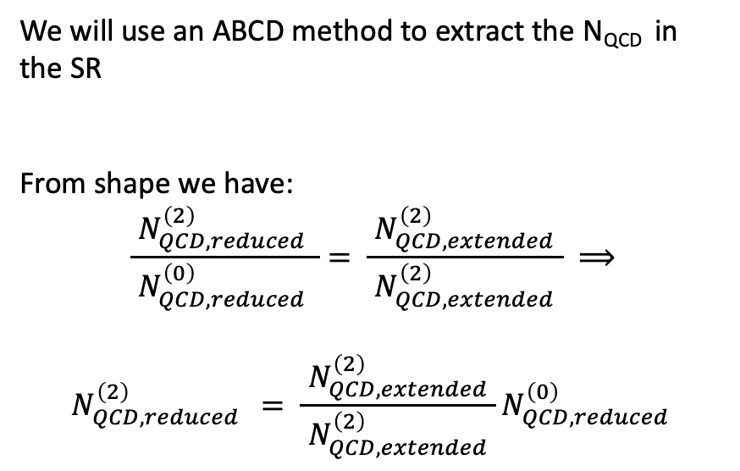
Region SRA
Transfer Factor Calculation
We will use an ABCD method to extract the N_{QCD} in the SR
From shape we have:
$$\frac{ N_{QCD,reduced }^{\left(2\right)} }{ N_{QCD,reduced }^{\left(0\right)} }= \frac{ N_{QCD,extended}^{\left(2\right)} }{ N_{QCD,extended}^{\left(2\right)} } ⟹$$
$$N_{QCD,reduced }^{\left(2\right)} = \frac{ N_{QCD,extended}^{\left(2\right)} }{ N_{QCD,extended}^{\left(2\right)} }N_{QCD,reduced }^{\left(0\right)}$$
2
SR
Btag region
0
CR
50
120
220
300
GeV
Region CRA
Top Mass Candidate
$$D_{reduced }^{(0)}−TT_{MC, reduced }^{(0)}$$
Taken from fit
NQCD in Reduced (SR):
2016: 846.365
2017: 677.041
2018: 1201.35

Slide 7
Fiducial Measurements (jetPt0) ABCD method and
2016
2017
2018
Output is not consistent with what we expected
We expect r ~ 0.85 for 2016, ~0.58 for 2017 and ~0.63 for 2018
Nqcd in SR reduced probably the problem

Slide 8
Fiducial Measurements (mJJ)
2016
2017
2018

Slide 9
Response Matrices (Unequal Binning, jetPt0)
2016
2017
2018

Slide 10
Response Matrices Particle (Unequal Binning, jetPt0)
2016
2017
2018

